Slide 1
Introduction: Transfer of Heat

Slide 2
Heat
A form of energy associated with the motion of atoms or molecules.
Transferred from higher temperature objects to objects at a lower temperature.

Slide 3
How Heat Can Be Transferred
Conduction
Convection
Radiation

Slide 4

Conduction
Transfer of heat through direct contact.
Occurs anytime objects at different temperatures are touching each other.
As long as the objects are in contact, transfer of heat will continue until the temperature of the objects is the same.

Slide 5
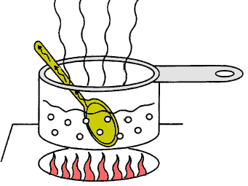
Conduction (continued)
Example: If you leave a metal spoon in a pan of soup that you are heating on the stove, it may burn your fingers. The spoon is in direct contact with the hot soup and heat is transferred to the spoon.

Slide 6
Conductors and Insulators
Some materials conduct heat better than others.
Materials that transfer heat well are called conductors.
Metals are usually good conductors.
Wood, paper and plastic are not.
Materials that stop the transfer of heat are called insulators (styrofoam, wool, fiberglass).

Slide 7
Convection
The transfer of energy in a liquid or gas.
When part of a gas or liquid is heated, the particles it is made up of move faster and spread out more.
The moving particles bump into other particles, causing them to move faster and spread out more.

Slide 8
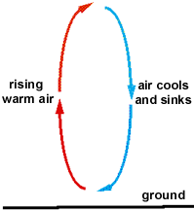
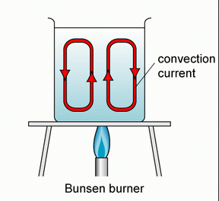
Convection Currents
When particles in the air spread out, they become less dense and generally rise above the unheated, more dense particles around them.
The denser masses of the gas or liquid move in to fill the space left by the heated particles.
The particles that move away from the source of heat become cooler and more dense.

Slide 9
Radiation
Energy transferred in the form of rays or waves or particles.
We will concentrate on the type of radiation that travels as electromagnetic waves.

Slide 10

Heat From the Sun
You can feel the sun warm your skin on a sunny day.
This is because the energy causes the particles in your skin to move faster = more heat energy.

Slide 11
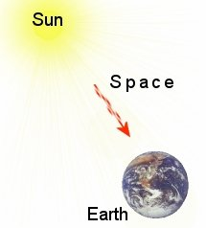
Electromagnetic Waves
Include visible light, microwaves and infrared light
Can travel through space.
The sun is our major source.

Slide 12
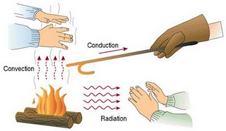

Slide 13
Convection = Basis of Most Winds
Air is heated by the surface of our planet.
Warm air rises and cooler air comes in to take it’s place.
2
Air further from the earth’s surface is cooler so the temperature of the air drops. As the air cools, it becomes more dense and starts to sink.
1
Warmer, less dense air is pushed up by the cooler, denser air.
3
Sinking air moves under warmer air, pushing the warmer air up.

Slide 14
More About This Concept
Convection is warmer at the earth’s surface so air near the earth’s surface is heated by the earth.
Warmer, less dense air rises.
It is cooler higher up in the atmosphere, so the air becomes more dense again and begins to fall.
Sinking air moves under warmer air and it all starts over again.

Slide 15
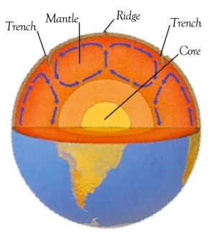
Also Happens Under Earth’s Crust

Slide 16
Convection Currents in the Mantle
There is a lot of heat within the earth.
The surface of the earth is cooler than the lower mantle.
Heat is transferred to the upper layers.
Spots where the material conducts more heat become hotter and less dense, so they rise towards the surface.
Denser material falls.

Slide 17
